Slide 1

Seed Classification 2004 – AI in Enterprise Systems
Saurav Bisht
100850875

Slide 2
Introduction
This project deals with the most general tasks of machine learning known as classification. Classification is a task that necessitates the application of machine learning algorithms to learn how to assign a class label to problem domain instances. The most basic example of this task is classifying emails “spam” or “not spam”.
There are total four main types of classification tasks:
Binary Classification
Multi-Class Classification
Multi-Label Classification
Imbalanced Classification
The classification being performed on this project is Multi-Class Classification.

Slide 3
Aim of the Project
The goal of the project is to determine the category of seed. To our problem there are three type of wheat seeds data (as listed in UCI machine learning repository).
Development Stages of Project
Dataset Exploration
Algorithm Implementation and model building
Flask API development
Front-end Mechanics
Deployment of the model

Slide 4
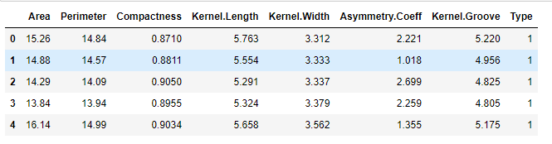
Seed Dataset
We have 7 attributes from three different types of wheat samples in our dataset. The goal of the investigation is to discover a distinct relationship between the physical characteristics of wheat seeds and the type of wheat.

Slide 5
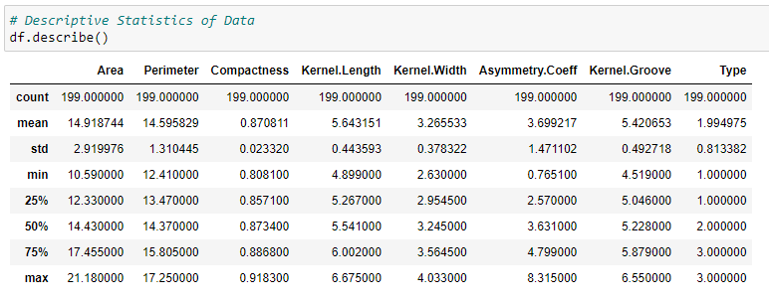
Data Set Exploration – Descriptive Stats
Since the data is clean, thus uniformity can be seen in the data

Slide 6

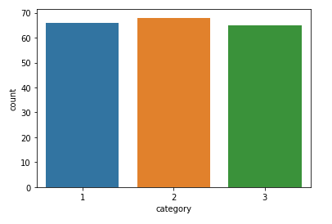
Class Imbalance check
The most common problem during a classification task the class imbalance ratio of the target variable.
From the plot we can clearly state that the model is balanced.

Slide 7
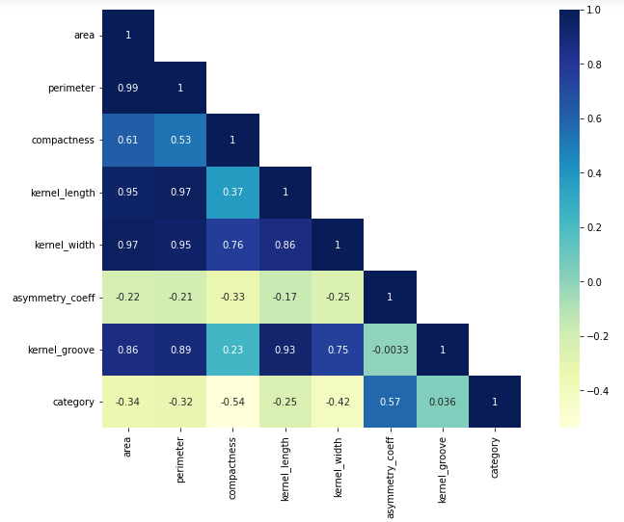
Correlation plot
Plotting the correlation plot of all the features with each other.
From the give plot we can say that Perimeter and Area are highest correlation
While asymmetry coefficient has least with most columns

Slide 8
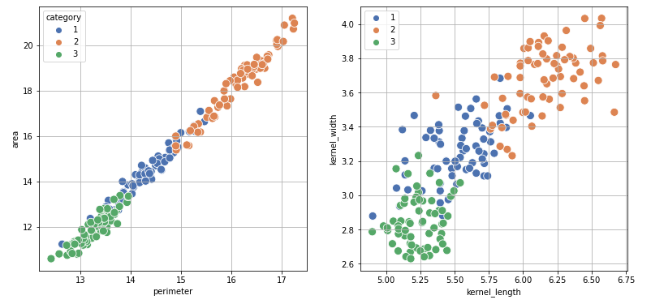
Scatter plot between highly correlated data

Slide 9
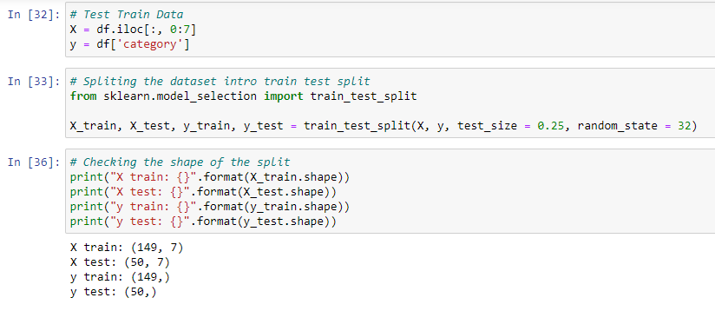
Train-Test split
The chosen ratio of the train test split was 70:30.
This being 70 data for training while 30 data for testing

Slide 10

Algorithm Implementation
Two algorithm were implanted for the task.
K means Clustering
Random Forest Classifier

Slide 11
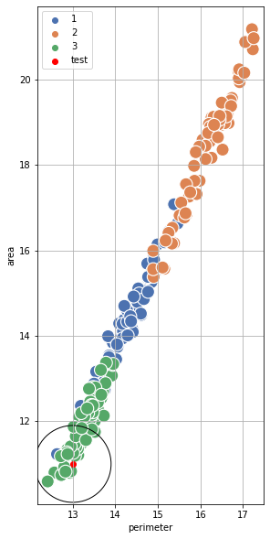
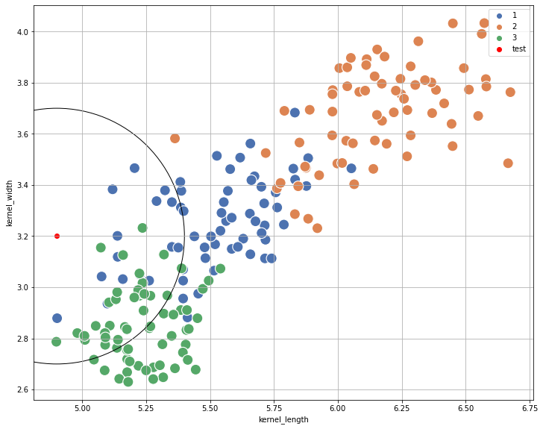
K means
New data point was tested over the k-means model
The predicted category was validated using the following scatter plot

Slide 12
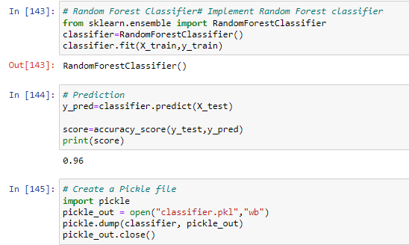
Random Forest Classifier
Random Forest classifier model was selected for the deployment
For the front-end of the application html was used while backend mechanics were implanted using flask
Model was deployed using heroku
Link to Heroku website:
https://wheat-demo.herokuapp.com/

Slide 13

Thank You

